Slide 1
Private Investment in Turkmenistan’s Transport Infrastructure
May 2012

Slide 2
Who We Are
IFC is the private sector arm of the World Bank Group.
Our mission is to reduce poverty by promoting private sector investment in developing countries.
  We manage privatisations
  We structure public-private partnerships (PPPs)
  We finance infrastructure projects
  We lend to and invest in private sector companies
  We help businesses list on stock exchanges
  We give advice to policymakers
Priority sectors are infrastructure, healthcare, education, agriculture and banking.
Staff of 3,400 bankers and technical experts located worldwide.

Slide 3
What We Do
IFC is an investor for its own account and a service provider to third parties.
Investment (“Buy-side”)
Advisory (“Sell-side”)
We provide long-term financing to private businesses and sub-national entities.
Europe and Central Asia represent 22% of the global portfolio of $12.2bn, or approximately $2.7bn in commitments.
We advise governments on how to attract private sector investment in infrastructure.
To date, we have advised on 165 projects in over 60 countries, mobilizing over $8bn of private sector investment.
IFC Commitments by Industry, FY 2011
IFC Advisory Project Expenditures by Region, FY 2011
Agribusiness 4%
Consumer & Social Services 4%
East Asia and the Pacific 13%
Trade Finance 38%
Global 17%
Europe and Central Asia 17%
Financial Markets 25%
Sub-Saharan Africa 25%
Latin America and the Caribbean 9%
Telecom & IT 3%
Funds 4%
Oil, Gas, Mining 2%
Manufacturing 7%
Infrastructure 13%
South Asia 11%
Middle East and North Africa 8%

Slide 4
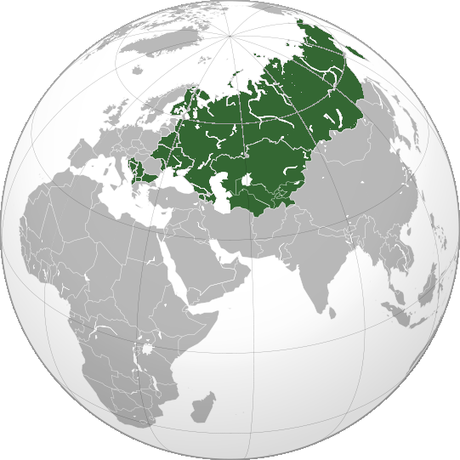
Our Role as Transaction Adviser
We can serve you from offices in Ashgabat
and elsewhere in Central Asia.
Regional coverage
Core functions
Identify “bankable” projects
Conduct due diligence
Prepare project contracts
Advise on the optimum financial structure
Identify qualified investors
Sell, negotiate, close
Provide financing
Fee structure
Advisory fees on cost-recovery basis
Retainer paid by govt., success fee – by investor
Market rates for financial products and services

Slide 5
Bold Development Objectives…
  The Turkmen Government’s Objectives are:
  To increase private sector share of GDP from 40% to 70% by 2020
  To privatize non-core sectors using transparent sales process
  To diversify economy away from reliance on extractive industries
  To improve regulatory environment
  To invest more in transport and communications infrastructure
IFC/World Bank can help the Government meet these objectives

Slide 6






… Engagement with IFIs should be further enhanced
$70m for GAC oil tankers on Caspian Sea
$125m for Gyzylgaya – Bereket - Etrek rail line
$2m for ice cream plant
$25m for Coca-Cola bottling plant
$1bn for fertilizer plant
$121m for Balkan Velayat water project
$371m for Gyzylgaya – Bereket - Etrek rail line
$4bn for S. Yolotan gas field

Slide 7
Airports
Discussion
  Annual PAX of 1.7m (2010) at Ashgabat and Turkmenbashi airports is sufficient to support O&M contract.
  Airports are high fixed-cost business and depends on air traffic volume for profitability.
  Airport operators typically derive revenues from airport charges levied on airlines to cover core airport services.
  50% of major airport operators’ revenues come from non-aeronautical charges (see table).
  Assessment of operational figures for both airports is necessary to better gauge potential private sector interest.
  Source: World Bank Development Indicators

Slide 8
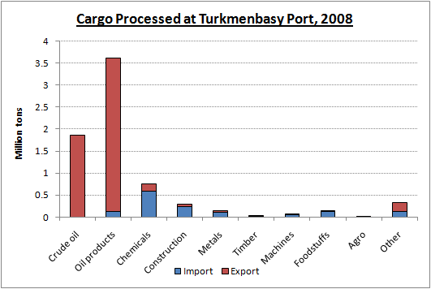
Seaports
Discussion
  Participation of private operators could improve throughput at Turkmenbashi Port.
  Currently, 80% of cargo consists of oil products. Instead of or in addition to pipelines, Turkmenistan could develop LNG (liquefied natural gas) storage.
  Turkmenbashi Port should develop intermodal freight operations. Characteristics of intermodal freight operations:
    Containerization – use of standard (ISO) shipping containers
    Rapid transfer of containers between modes of transport
    Minimal cargo handling, resulting in lower damages and losses
  Source: TRACECA Program report (2009)
LNG Shipping: Advantages and Drawbacks
Advantages | Drawbacks
Relatively low cost | Technologically demanding
Adaptability in routes, scale, time | Potentially, lack of skilled shipping crew
Alternative to pipeline-delivered oil/gas, in high demand | Ambiguous environmental benefits, more energy efficient for long shippings

Slide 9
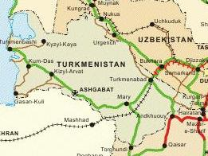
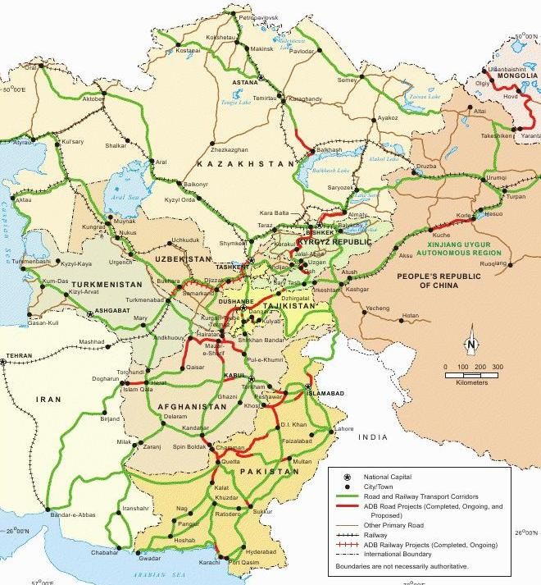
Roads
Discussion
  IFC can help attract private sector to operate two highways: Ashgabat–Turkmenabad and Ashgabat–Turkmenbashi (CAREC Corridor #2).
  Private investor would recoup investment through tolls and/or availability payments made by government based upon:
    Construction milestones
    Performance criteria
    Minimum traffic levels
  Truck transport dominates domestic haulage; however, 80% of EXIM freight goes by rail through Sarakhs.
www.captainsjournal.com

Slide 10
PPP is not Just About Investment
Contractual incentives
Expertise and know-how
Increased efficiency
Implementation Capacity

Slide 11
Private Investment: a Win-Win Solution
Government
Investors
Transfer commercial/financial risks to investors.
Achieve appropriate risk-adjusted rate of return
Set standards, regulate returns.
Obtain political support for project.
Ensure tariffs are affordable.
Project Contracts
Manage technical, commercial and regulatory requirements.
Value potential subsidies.
Secure limited-recourse financing.
Develop local private sector.
Advisory Mandate
Tender Process
Ensure project is feasible.
Prepare “bankable” structure.
Identify qualified investors.
Maximise competition.
Sell, negotiate, close...
IFC Transaction Advisory
11

Slide 12
Revenue Models
Highway Public
Highway PPP
Investment
Maintenance
Investment
Maintenance
Government
Government
Private Sector
subsidies
guarantees
taxes
levy
tolls
taxes
levy
tolls
Users / Tax-payers
Users / Tax-payers

Slide 13
Revenue Models (continued)
 | Default Model | Model 1 | Model 2
Concession: | Public procurement | Build-Operate-Transfer (BOT) | Operation & maintenance (O&M)
Scope: | Operation and maintenance contracted to private sector | Private investors to build, operate and maintain road | Investor to operate and maintain facilities built with govt. Financing
Duration: | +1 years | +25 years | +15 years
Revenue: | Not applicable | Investors collect user charges from and availability payments from government | Investors collect user charges
Financing: | Facilities built and operated using government budget. | Investor uses own equity & debt. Government to fund payments from budget | Investor uses own equity & debt. Government to fund payments from budget
Strengths: | No or subsidised user charges Government maintains control Private operator can be changed quickly if performance is unsatisfactory | Design, build & funding risk shifted to private sector Impact on government budget somewhat reduced Long-term concession encourages investment | Enhanced facility lifespan/safety Payments to government reduce debt /pay Operational risk shifts to investors
Weaknesses: | Risks borne by government “User pays” principle not applied High impact on govt. budget Short-term contract subject to frequent renewal | Investors/financiers may need guarantees (public sector performance or credit) User charges may be unpopular | Design, construction and financing risk still with govt. Investors may be unwilling to bear 100% traffic risk Tolls may be unpopular

Slide 14
Cash Flows Throughout Project Life
CAPEX
Dividends (Equity)
Taxes/Fees
Debt Servicing (Interest/Principal)
Taxes/Fees
OPEX
GRANT (PUBLIC)
Operating Revenues and/or Availability Payment
EQUITY (PRIVATE)
DEBT (PRIVATE)
Construction
Operation

Slide 15
Value for Money
Discussion
$
Capital Expenditure
  PPP projects should be compared to public option over their life.
  Budget – replacing capital expenditure by recurrent payments.
  Risk of limiting future investment capacity.
  Requires management of payments associated with PPP.
  Ministry of Finance central to this process.
Maintenance
Traditional Procurement
$
PPP with Availability Payments

Slide 16
Good PPP Projects Meet 3 Criteria
Value for Money
Ultimately cheaper over life of contact
Risk Transfer
Risks transferred to party best able to managed it
Affordability
Long-term financial implication for Government

Slide 17
Typical Project Cycle
Transactions typically take longer to close in Emerging Markets.
Capacity-building is an important part of implementing a deal.
I. Origination
II. Analysis
III. Implementation
Internal Clearances
Assess PPP Options
Define Transaction Structure
Market to Investors
Prepare PPP Contract
Conduct Tender
Award / Financial Closing
Mandate signing
Documentation
Team on-boarding
Project kick-off
Technical and legal analysis
Stakeholder discussions
Risk allocation
Payment mechanism
Info memo
Road show
Data room
Service Standards
Performance targets
Payment procedures
Penalties
Monitoring
Pre-qualification
Technical evaluation
Financial evaluation
Winner selection
Contract effectiveness & assumption of service obligations
9 – 18 months

Slide 18












Select Experience in Transport
Concession
Loan
Concession
Concession
Concession
Concession
Madinah International Airport, Saudi Arabia
IFC mandated as
Financial Adviser
$45m to operator of cargo terminal at Port of Buenos Aires
Argentina
IFC Investment Division
Cargo-handling at Port Louis in Mauritius
IFC mandated as
Financial Adviser
Bahia 093 motorway in northeast Brazil
IFC acted as
Financial Adviser
BR-116 motorway
in Brazil
IFC acted as
Financial Adviser
Rehabilitation of Cairo-Alexandria toll road in Egypt
IFC mandated as
Financial Adviser
CAPEX Facility
Loan
PPP
Concession
Greenfield PPP
Concession
$10m to Tbilisi Airport in
Georgia
IFC Investment Division
$120m for Queen Alia International Airport in Jordan
IFC mandated as
Financial Adviser
Expansion of
Port of Cotonou in
Benin
IFC mandated as
Financial Adviser
Ruta del Sol motorway in
Colombia
IFC mandated as
Financial Adviser
Construction of Bar – Boljare motorway in Montenegro
IFC mandated as
Financial Adviser
Amman ring road in Jordan
IFC mandated as
Financial Adviser

Slide 19
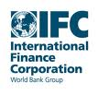

Thank You
Petyo Nikolov
Senior Consultant
Transaction Advisory
Europe and Central Asia
Bul. Kralja Aleksandra 86-90. 3rd floor
11000 Belgrade, Serbia
Telephone: +381 11 330 8956
Mobile: +381 634 05661
Email: pnikolov@ifc.org
www.ifc.org/infrastructureadvisory
Joseph Mik
Investment Officer
Transaction Advisory
Central Asia
41A Kazybek Bi Str., 1st Floor
050010 Almaty, Kazakhstan
Telephone: +7 727 2 980 586 ext 301
Mobile: +7 701 220 67 56
Email: jmik@ifc.org
www.ifc.org/infrastructureadvisory
Serdar Jepbarov
Operations Officer
Turkmenistan
United Nations Building, c/o World Bank
Galkynysh Street, 40
Ashgabat 744000
Telephone: +993 12 262 099
Facsimile: +993 12 491633
Email: sdjedbarov@worldbank.org
www.worldbank.org/turkmenistan
Serik Sharipov
Consultant
Transaction Advisory
Central Asia
41A Kazybek Bi Str., 1st Floor
050010 Almaty, Kazakhstan
Telephone: +7 727 2 980 586 ext 258
Mobile: +7 705 570 56 28
Email: ssharipov@ifc.org
www.ifc.org/infrastructureadvisory

