Slide 1
Public-private partnership in the development of transport projects in Central Asia and Caspian region
Anthony Pearce
Honorary Director General, International Road Federation

Slide 2
Agenda
Transport PPPs internationally
Road PPPs
Regional examples
Conclusions

Slide 3
Agenda
Transport PPPs internationally
Road PPPs
Regional examples
Conclusions

Slide 4
PPPs
4 main roles for the private sector in PPPs:
additional capital;
better management and implementation skills;
value added to the consumer and the public at large;
better identification of needs and optimal use of resources.
Around 1000 PPP road schemes in nearly 60 countries worldwide.
Notes:
PPPs have a long history, particularly in the UK. Many countries needing to upgrade their infrastructure could potentially benefit from the PPP approach.
In the road sector there are around 600 PPP concessions in nearly 60 countries worldwide. To a very large extent, the future of transport is intimately linked to the future development of PPPs, and this in turn is linked to the capacity of the private sector to fund viable projects.
It is still not clear whether the sub-prime credit crisis has made the funding of large infrastructure projects easier because funds are not going into more dubious investments, or more difficult because of the much-publicised “credit-crunch”. In either case the focus of both the public and private sectors must remain on creating the soundest, most viable PPP projects.

Slide 5
Main Characteristics of PPPs
Risk-sharing between public and private sectors
Long-term relationship between parties
Public service and ultimate regulatory responsibility remain in public sector
Using private sector skills for public sector services
Contracts for services, not procurement of assets
Output, not input, specifications
Payments related to service delivery
Whole life approach to design, build and operation

Slide 6
General issues
PPP arrangements are growing in use and acceptance as an alternative and effective method to mobilize additional financial resources and benefits from private sector efficiencies
PPPs are not the only way to deliver project financing and project realisation. They do not provide a ‘miracle’ solution nor a quick fix and should only be used where appropriate and where it is able to deliver clear advantages and benefits
There is a multitude of PPP structures and the appropriate must be selected according to project type, needs and sector. There is no single perfect model.

Slide 7
KEY Structural Questions
What is the partnership project?
Under what legal authority does the public entity undertake the project?
What type of entity is the private sector?
Are there pre-existing assets being contributed / new assets being constructed?
Who will own the assets?
What capital resources are available to the partners / who will provide any needed capital and how?

Slide 8
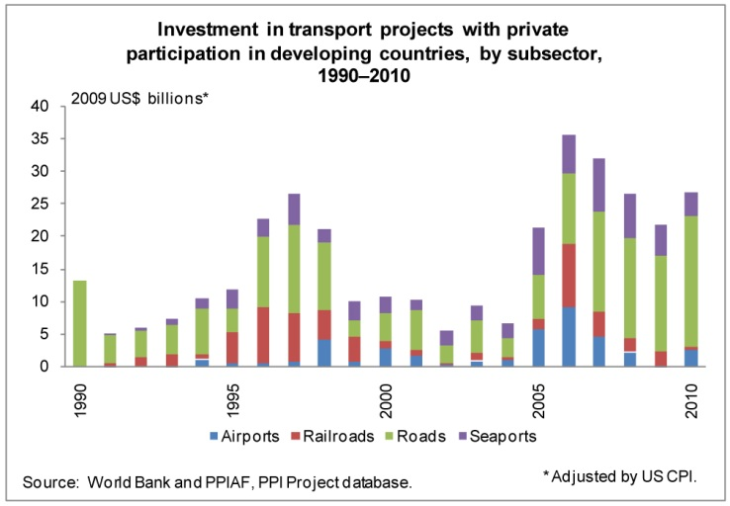
PPP projects
In 2010 92 transport projects, involving investment commitments of US$25.8 billion, reached financial or contractual closure in 16 low- and middle-income countries.

Slide 9
Agenda
Transport PPPs internationally
Road PPPs
Regional examples
Conclusions

Slide 10
Typical concession contract

Slide 11
Types of ppp
Lots of letters…
Let’s look at a practical example
B – Build D – Design F – Finance L – Lease M – Maintain O – Operate T – Transfer
BOT – Build Operate Transfer
BOO – Build Own Operate
BOOT – Build Own Operate Transfer
DBF – Design Build Finance
DBFO – Design Build Finance Operate
DBO – Design Build Operate
BLT – Build Lease Transfer
BTO - Build Transfer Operate
DBFOM – Design Build Finance Operate Manage

Slide 12
How can it be paid back?
Options:
Tolling
Shadow tolling
Minimum revenue guarantee
Annuity
Availability payments
Other income

Slide 13
Tolling only
Rule of thumb is that, with a 20 year cost recovery period and a toll of €0.03 to €0.06 per vehicle km for light vehicles:
To cover: | Vehicles per day
Construction and maintenance | >15,000 vpd
Rehabilitation, operation and maintenance | > 6,000 vpd
Maintenance costs | > 3,500 vpd
Toll collection only | > 1,500 vpd

Slide 14
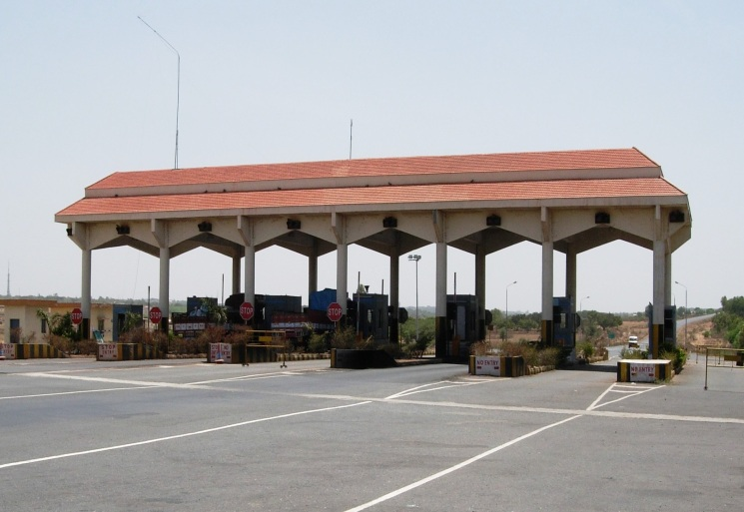
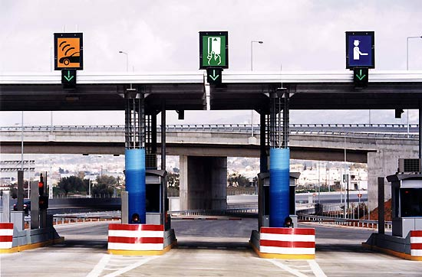
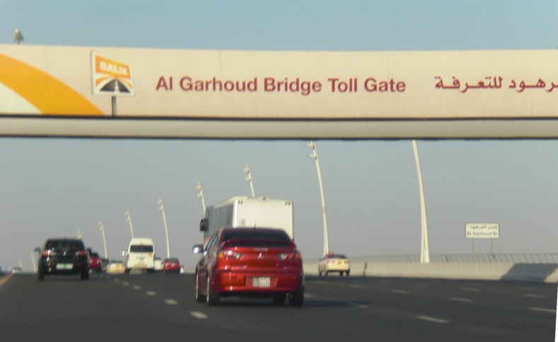
Collecting tolls
Manual tolling
Combined manual and
Electronic tolling
All electronic tolling

Slide 15
Shadow tolling
Toll charges are paid directly by the government / project sponsor to the concessionaire according to a predetermined toll structure.
Shadow toll can be paid in addition to the toll being collected from road-users (for example the difference between the toll-charge that provides a normal rate of return and the toll-charge users are willing to pay could constitute the Shadow Toll).

Slide 16
Minimum revenue guarantee
A major challenge is the correct allocation of risks between the public and the private sectors - traffic risk is difficult to allocate because neither the concessionaire nor the government can reasonably control it.
Also traffic forecasts have proved to be inaccurate.
Consequently, many governments mitigate traffic risk by providing a minimum income guarantee.

Slide 17
Annuity
Payment to the concessionaire is fixed without reference to the traffic volume.
Government retains the right to charge a toll from users at any stage of the project.
Generally, it also retains rights relating to property development, advertising along the project site, etc.
The key difference between shadow toll and annuity is traffic risk:
under shadow toll, traffic risk borne by concessionaire;
under annuity system, concessionaire does not bear the traffic risk.

Slide 18
Availability payments
Made based on achievement of particular project milestones or performance standards.
Project milestones can refer to the road being open by a certain deadline, while performance standards can be measured operationally, such as lane closures for maintenance purposes, incident management, or level-of-service performance.
Often used for toll roads that are not expected to generate sufficient revenue to pay for their construction and operation.
There is less overall risk to the operator than with a traditional concession - the concessionaire receives a predictable, fixed set of payments over the life of the agreement.

Slide 19
Financial incentives
Grants: generally for construction for cost and balance, if any, should be used for meeting the O&M cost.
Low interest loans: generally governments can borrow at lower cost than the private sector.
Revenue shortfall loan: if there is a revenue in any year low interest loan may be provided by the government.

Slide 20
Fiscal incentives
Tax incentives are a very important component of any fiscal package. The various forms of tax incentives could be:
tax holiday on income tax for the concessionaire;
exemption/rebate on customs duty for imported equipment used in construction or operation of highway;
exemption of stamp duty applicable to various contracts in the project;
exemption/rebate/deferment of other taxes value added tax, employee taxes, etc.

Slide 21
Ancillary revenues
The concessionaire may be given permission for property development along the highway. The various alternatives for ancillary revenues could be:
transport terminals - garages, service stations, warehouses, rest houses and other relevant infrastructure;
restaurants, shops and motels;
publicity and advertising space.
Estimated that Moscow-St Petersburg road will make 30% of revenue from ancillary revenues

Slide 22
Which model to choose?
Will users pay for road?
is the traffic volume predictable?
is the traffic volume expected to be high?
is there a need to reduce congestion?
is there willingness to pay?
move towards payment for distance travelled?
If “no”, then:
shadow tolls or
Annuity or
availability payments.

Slide 23
Traditional road maintenance
Road administrations have increasing difficulties under traditional works contracts to ensure:
that design of works is adequate
that the quality of works is adequate
that works are completed at the price given by winning contractor
that roads are maintained after construction works are completed.
Improved road sector performance can be achieved because PPPs adopt a life cost cycle approach.

Slide 24
Deterioration of road quality

Slide 25
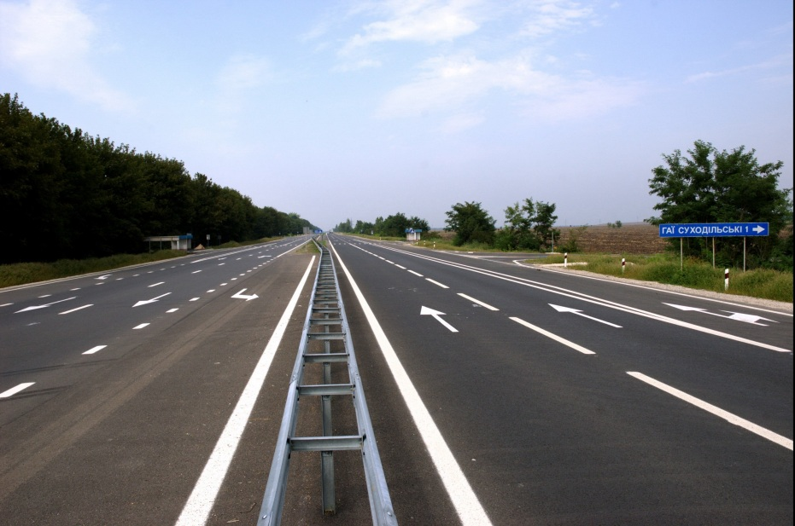
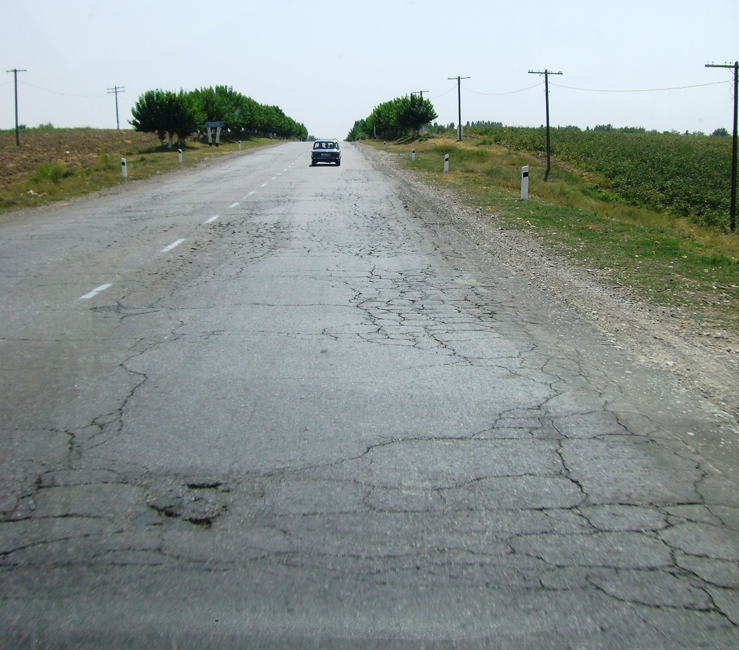

Slide 26
Optimum level of service determination
Target
Level
of
Service

Slide 27
Output and Performance-based Road Contracts (OPRC)
Payments under OPRC are linked to outputs / outcomes.
OPRC can be used to…
Manage and maintain existing good roads over multi-year periods.
Bring roads to a maintainable condition and then manage and maintain them for several years.
Rehabilitate and improve roads, and then manage and maintain them for several years.
Construction of new roads, followed by a long period of management and maintenance.

Slide 28
Agenda
Transport PPPs internationally
Road PPPs
Regional examples
Conclusions
Kakakhstan PPP projects
Proposed road Almaty-Issyk Kul
Logistics hub at Navoi, Uzbekistan

Slide 29
Kazakhstan PPP projects

Slide 30
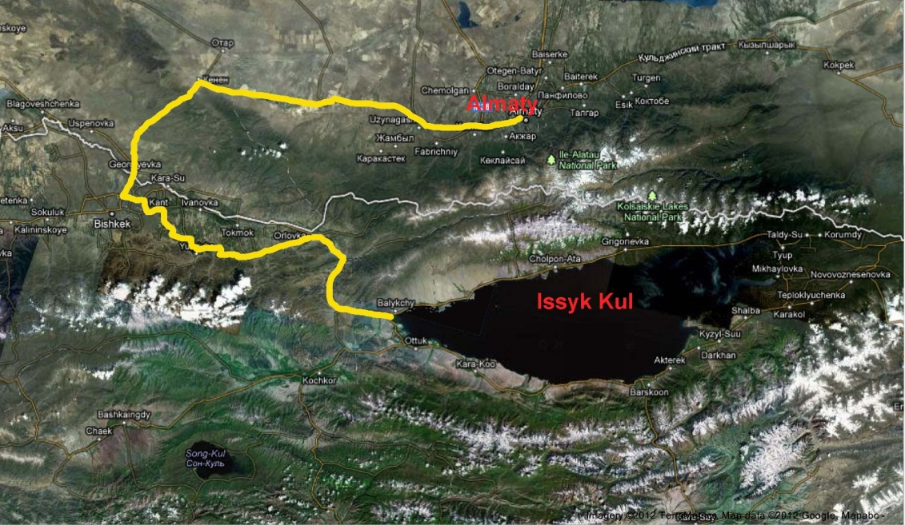
Proposed road Almaty-Issyk kul
New highway between Almaty city and Issyk-Kul.

Slide 31
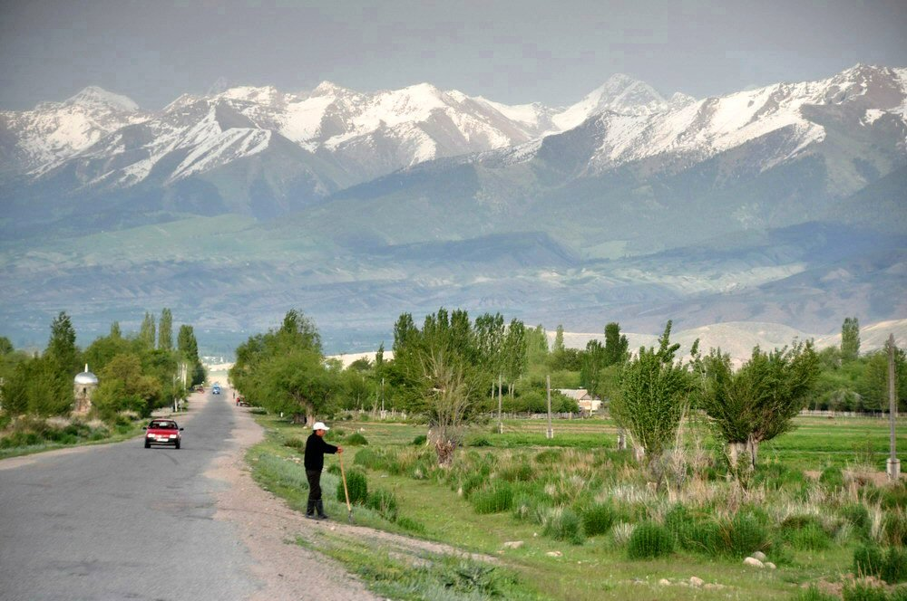
Proposed road Almaty-Issyk kul
New highway between Almaty city and Issyk-Kul.
Estimated traffic:
Peak 10 000 veh./day
Average 3 000 veh./day
Construction period: 2 years
Cost: $ 50 million?
Distance ~ 130 km - cut journey by 200 km.
Source: National Agency Kazinform

Slide 32
Proposed road Almaty-Issyk kul
Toll: $7 = 8¢ /km (saving on 200 km fuel ≥ $10)
Maintenance: annual 2.5% of asset value
periodic 20% after 8 years
3,000 vehicles: 85% cars, 15% trucks
Annual income: $9 million

Slide 33
Proposed road Almaty-Issyk kul
Income possibly sufficient to cover costs at 3,000 vpd as a pure toll project.
Some public sector grant to support regional development?
Therefore options are:
Government(s) grant 35%; or
PPP is structured as (say) 35% availability payment and 65% based on tolls; or
Governments guarantees a certain minimum traffic flow.

Slide 34
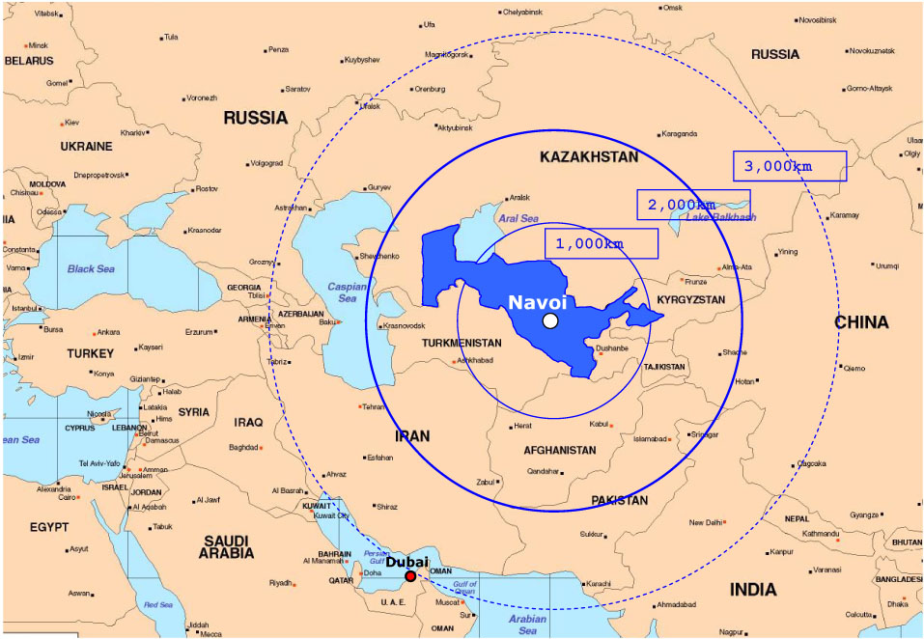
Logistics hub Navoi, Uzbekistan
At the crossroads of international "North-South" and "East-West" land and air corridors.
Notes:
10 capitals of different states with total population of 100 million within 2000 km of Navoi.

Slide 35
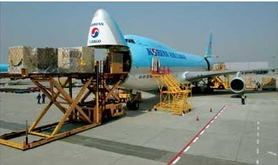
Logistics hub Navoi, Uzbekistan
Korean Air cargo has 150,000 sq m cargo terminal to handle 100,000 tons a year air freight rising to 500,000 tons.
747-400F Incheon-Navoi-Milan flights started in August 2010.
"Korean Air will spare no effort in supporting the growth of Navoi into Central Asia's best logistics hub."
Notes:
Korean Air Lines is the world’s largest cargo carrier.
From SE Asia to Europe via Navoi is 1000 km shorter than via Dubai, saving 1.5 hours flying time and 15 tons of fuel per flight.
There have been Korean – Navoi - Milan flights since 2008, but since August 2010 the frequency has been increased to 3 times weekly round trip.
Other cities connected to Navoi include Delhi, Bangkok, Mumbai, Moscow, Brussels, Dubai and Almaty.
KAL has leased A300-600F freighters to Uzbekistan Airways to provide regional feeder services.

Slide 36
Logistics hub Navoi, Uzbekistan
Free Economic Zone with manufacturing of:
Electro-technical and telecommunications equipment;
Machinery and computers;
Pharmaceuticals and medical ;
Plastics and polymers.
Notes:
Production to begin in 2011 and as a result the capacity of the existing cargo facility will be exceeded in 2012.

Slide 37
Logistics hub Navoi, Uzbekistan
Forecast traffic:
2011 – 486,000 tons
2020 – 1.04 m tons
2030 – 1.20 m tons
Extensive road (E40), rail and air connections
Notes:
FIEZ traffic will be around 40% of the total from 2015 onwards.

Slide 38
Logistics hub Navoi, Uzbekistan

Slide 39
Agenda
Transport PPPs internationally
Road PPPs
Regional examples
Conclusions

Slide 40
What Have We Learned?
Successfully concluding a transport PPP is a challenge:
As a result of unrealistic and aggressive bids, a large number of projects face re-negotiation
Government commitment can disappear in periods of financial stress
Historically only 55% of proposed projects have reached financial close.

Slide 41
What Have We Learned?
Cost recovery is a major challenge:
Full cost recovery is only achievable in some transport sub-sectors
Revenue projections often suffer from a bias towards optimism
Access to local currency funding is a critical success factor for infrastructure projects with local currency revenues
The vulnerability of PPP projects to changing political, financial and economic circumstances is often underestimated

Slide 42
Conclusions
PPPs enable the public sector to realise infrastructure projects by making use of the skills and experience of the private sector.
In many cases they may also involve private finance.
PPPs are NOT just about money, but about quality and value.
But they are complex to design, implement and manage.
A systematic approach with the highest political support essential.

Slide 43
Thank you for you attention
Anthony Pearce
apearce@irfnet.net

