Slide 1
Prospects and Challenges of Rail Ferry and Ro-Ro transport between Azerbaijan, Turkmenistan and Kazakhstan
TRACECA LOGISTICS PROCESSES AND MOTORWAYS OF THE SEA II
Michel Gueriot
LOGMOS Key Expert II
May 2012
Ashkhabad, Turkmenistan
This project is funded
by the European Union
A project implemented by
Еgis International / Dornier Consulting

Slide 2
Main project data
Logistical Processes and Motorways of the Sea II in Armenia, Azerbaijan, Georgia, Kazakhstan, Kyrgyzstan, Moldova, Tajikistan, Turkmenistan, Ukraine, Uzbekistan - EuropeAid/ 2011/264 459
Project period: 27 April 2011 – 26 April 2014
Beneficiary countries:
Direct – the ENPI East partners (Armenia, Azerbaijan, Republic of Moldova, Ukraine and Georgia) and the Central Asia TRACECA countries (Kazakhstan, Kyrgyzstan, Uzbekistan, Tajikistan and Turkmenistan)
Indirect – Bulgaria, Romania, Turkey

Slide 3
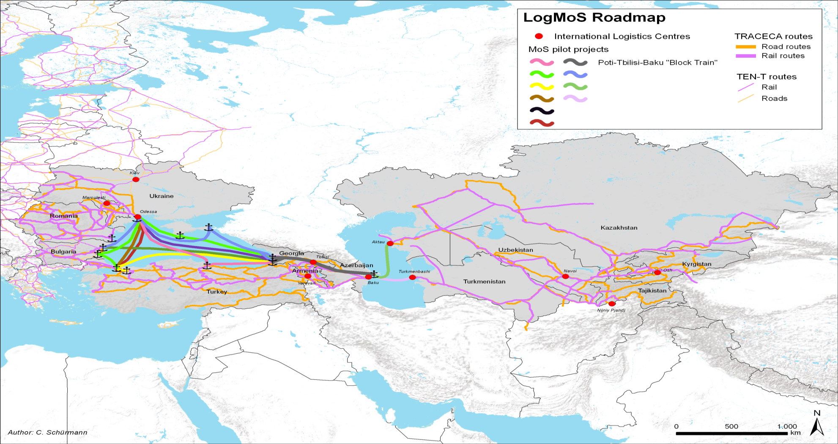

Slide 4
Specific Project Objectives
Overcoming logistics bottlenecks with the objective to enhance trade between the EU, the beneficiary countries and beyond.
Facilitating an efficient and seamless flow of goods along the TRACECA Corridor between both sides of the Black and the Caspian Seas, ensuring good interoperability between the ports and the hinterland through regular maritime, rail, road and inland waterway transport connections.
Addressing regulatory and border-crossing procedure issues to improve the performance of maritime, port, and land transport operations with a specific focus on Ro-Ro and containerized trade and the implementation of block container train and contrailer services.

Slide 5
The Project:
continues the effort of three EU-funded TRACECA projects, which were
implemented in 2008 – 2011:
Motorways of the Sea (MoS) for Black Sea and Caspian Sea
International Logistical Centres for Western NIS and Caucasus
International Logistical Centres for Central Asia
targets the implementation of the 16, now 20, pilot projects selected under the
previous projects which consist in a network of 11 logistics centers in the
Western NIS, Caucasus and Central Asia countries, one block-container train
operation through the Caucasus along the TRACECA Corridor backbone and 5
MoS initiatives for improving the existing maritime links in the Black and
Caspian Sea
aims at the identification, selection and when possible implementation of new
pilot projects

Slide 6
MoS Pilot Projects in the Caspian Sea
A changing environment
TRACECA countries have felt the need to review their approach to
transport issues in view of the globalization of the economy,
Considerable infrastructure investments are going-on:
the new Baku Port and International Logistics Center at Alyat,
the renovated railway link Baku-Tbilisi-Kars which will link Asia and
Europe through Anatolia and the Marmaray Tunnel under the Bosphorus,
the railway connection Zhezkazgan-Beineu which will shorten the
distance between the Chinese border and the Caspian Sea by 1,000 km,
are due to be operational in the few coming years.
·

Slide 7
Plans for the rehabilitation and extension of the ports of Poti, Aktau and Turkmenbashi and construction of logistics centers for the 2 Caspian ports have been approved and under implementation or due to be implemented soon.
Soft measures which aim at facilitating trade and border-crossing procedures are also either under implementation or considered in all the TRACECA Region: Georgia is working at implementing the PAIES system with Ukraine which already works between Ukraine and Moldova and is under implementation between Ukraine, Belarus and Lithuania. The TIR-EPD system is in force already in 5 TRACECA Countries (Ukraine, Moldova, Romania, Bulgaria and Georgia).

Slide 8
The scope of the TRACECA concept is changing: the Regional Corridor
created in 1993 to link Europe to Eastern and Central Asia countries is
becoming a Trans-continental Axis connecting Europe to China truly
renewing the old Silk Road.
Unexpected concerns have emerged in relation with the safety of sea-borne
transport. Fluctuating but generally increasing freights greatly depending upon
oil prices and the introduction of slow steaming allowing to reduce fuel
consumption and therefore costs but resulting in longer transit-times start also
weighing on users’ decisions regarding routes and modes of transport.
The supply chain concept based on uninterrupted just-in-time delivery calls for
the development of fast tracks and alternative modes to round-the-world sea-
borne only transport.

Slide 9
The steady rapid economic growth of TRACECA countries such as Turkey and
peripheral regions such as Western China implies the enhancement of existing
routes and development of new ones through Central Asia and the Caspian
Sea to reduce travel times and transport costs.
Globalization will thus ineluctably bring about an increase in the transit function and maritime role of the Caspian Sea TRACECA littoral countries, Kazakhstan, Turkmenistan and Azerbaijan. These countries have recognized the benefits they can expect from these developments and expressions of political will to implement necessary corresponding measures start being heard.

Slide 10
The existing intermodal transport offer in the Caspian Basin
- The main general cargo, shipping services are the rail-ferries
operating between Baku, Aktau and Turkmenbashi,
- In the rest of the world many transports which previously took place in
wagons and on rail-ferries are now carried out in trucks and Ro-Ro
vessels and even more in containers,
- Although offering frequent departures, the existing services are not
working according to schedules because of inadequate and/or
obsolete port handling and border-crossing procedures as well as
delays in railway operations and planning, insufficient port railway
equipment and shunting tracks

Slide 11
The existing intermodal transport offer in the Caspian Basin
- This results in waiting times at roads, excessive berth occupancy and
under-utilization of the ports and of the rail-ferry fleet,
- The same applies for the recently-opened Ro-Ro services reducing
their attractiveness and hampering their development while the
market demand for this type of transport is huge and increasing. The
difficulty is even greater in the case of the Ro-ro trade due to the lack
of adequate berths in Aktau and Turkmenbashi,
-There are no dedicated container services in the Caspian and no
regional or international block container trains on either side of the
Sea. The only existing container operation is the carriage of NATO
non-commercial humanitarian cargo to Afghanistan performed by non-
specialized general cargo vessels.

Slide 12
Prospects and challenges for improving the transport supply
- Infrastructure: this is an important component but time is needed before
the benefits of corresponding investments can be reaped,
- Soft measures: efficient procedures reducing border-crossing, port
handling and sea-passage transit-times can be implemented quicker and
more easily. They result in an increased attractiveness of the existing
services, and therefore in an increased trade volume. Besides, such steps
have to be taken compulsorily before the completion of infrastructure
works so as to ensure the optimal use of the rehabilitated / new facilities
and the best return on investment, especially in case same is financed
through loans.

Slide 13
Prospects and challenges for improving the transport supply
Soft measures involve no or very small investments. Vocational staff education and training often represent the main part of corresponding projects. For the LOGMOS Project, in the Caspian Basin, they address:
border-crossing issues which are twofold:
- procedures on the borders (including ports) must be quicker, simplified
and harmonized in accordance with international conventions signed by the
TRACECA member States, and made well-known in advance to the user.
This is evidently best achieved where governmental agencies use pre-
declaration systems (TIR-EPD, PAIES, NCTS). At land borders, joint border-
crossing examination (as, for instance at Sarpi on the Turkish-Georgian road
border) represent an example of best practice.

Slide 14
Prospects and challenges for improving the transport supply
port procedures which include planning of the berthing and handling of
vessels, vessels’ inward and outward clearance, cargo storage
monitoring, implementation of port community systems and users’
friendly information portals.
The ultimate targets are:
To reduce and possibly eliminate waiting time at roads and at berth for
vessels plying regular services, Rail-ferries, Ro-ros and Ro-Pax, and, in the
future container feeder vessels,
To improve the predictability and therefore attractiveness of these services
and meet the market requirements by having them running on schedule,

Slide 15
Prospects and challenges for improving the transport supply
To develop gradually pre-booking systems for Ro-Ro and Ro-Pax vessels
equivalent to those existing in other seas, enhancing the reliability of
Caspian liner shipping services,
To foster when possible the use of common transport documents (such as
the CIM / SMGS common railway consignment note) enabling to develop
seamless international block container train operations,
To support the implementation of integrated intermodal tariff platforms to
enable users to obtain easily transparent door-to-door quotations.

Slide 16
All this can result only from a close, concerted, permanent cooperation between stakeholders throughout TRACECA
Ports
Railways
Shipping Companies
Trucking companies
Users
State
And
State Agencies

Slide 17
Thank you for your attention!
Contact LOGMOS team:
8, Lysenko street, office 39, Kiev 01034, Ukraine
+380 44 234 03 88, +380 44 288 08 92
 logmos.egis-international@egis.fr

