Slide 1
European road transport at a crossroads – which way now?
UNTRR conference on the Mobility Package
Bucharest, 21 September 2017
Matthias Maedge, General Delegate

Slide 2
What is the Mobility Package?
Revision of the Access to Profession & Road Haulage Market
Revision of Directive on the Use of Hired Goods Vehicles
Infrastructure Charging - Vehicle Taxation – Interoperability of charging systems
Revision of the Enforcement Directive
Application of Posting of Workers in road transport
Revision of driving and rest periods & tachographs
Proposal for Regulation on monitoring and reporting of CO₂ emissions from and fuel consumption of new heavy-duty vehicles

Slide 3
Why the Mobility Package?
EC aims
Efficient Enforcement
Innovation
Fair Competition
Simplification & harmonisation
CO₂ reduction
Social fairness

Slide 4
Mobility in Europe
Source: https://ec.europa.eu/transport/sites/transport/files/mobility-package-factsheet-overall.pdf

Slide 5
IRU policy on the Mobility Package
Simplify - Clarify
Efficient Enforcement
No market opening – no extra barriers

Slide 6
Mobility Package Rapporteurs
Access to the market and profession
Rapporteur: Jens Nilsson (S&D, SE)
Shadow rapporteurs: Elisabeta Lukacijewska (EPP, PL), Pavel Telička (ALDE, CZ), Peter Lundgren (EFDD, SE)
Hired vehicles
Rapporteur: Claudia Monteiro De Aguiar (EPP, PT)
Shadow rapporteur: Lucy Anderson (S&D, UK)
Eurovignette & EETS
Rapporteur (overall): Christine Revault d’Allonnes-Bonnefoy (S&D, FR) + Vehicle taxation: Deirdre Clune (EPP, IE)
Shadow rapporteurs: Georges Bach (EPP, LU), Dominique Riquet (ALDE, FR), Daniela Aiuto (EFDD, IT) + Vehicle Taxation: Claudia Țapardel (S&D, RO), Dominique Riquet (ALDE, FR)

Slide 7
Mobility Package Rapporteurs
Posting of workers and enforcement
Rapporteur: Merja Kyllönen (GUE/NGL, FI)
Driving and rest times & tachographs
Rapporteur: Wim van de Camp (EPP, NL)
Shadow rapporteur: Isabella De Monte (S&D, IT), Gesine Meissner (ALDE, DE), Daniela Aiuto (EFFD, IT)
Shadow rapporteurs: Izaskun Bilbao Barandica (ALDE, ES), Andor Deli (EPP, HU)
Monitoring and reporting of CO2 emissions from and fuel consumption of new heavy-duty vehicles
Rapporteur: Damiano Zoffoli (S&D, IT)
Shadow Rapporteur: Nils Torvalds (ALDE, FI)

Slide 8
Access to the profession
EC proposal
Extended to cover <3.5 tonne vehicles
Tougher establishment conditions (letterbox companies)
IRU view
Exemptions for certain services (express delivery)
Improve control effectiveness of conditions, through digitalisation
Alternatives
Define list of establishment criteria.
Enlarged scope on good repute (social & labour conditions)
Strong impact on risk-rating status (SMEs!)
No application of PWD to assess good repute.
Extend scope to access to the market (apply same rules as for HDVs).

Slide 9
Access to the market
EC proposal
Cabotage – 5 days, unlimited, PWD from day 1
IRU view
Keep status quo (7 days, 3 operations, no minimum checks) or alternative solution – no to EC proposal
Minimum roadside checks (2% to 3% by 2020-22)
Fewer or more days – cooling-off period
No delay on smart tachograph
Enforceable rules (incl. registration plate in eCMR)
Alternatives
Cabotage rights versus quality conditions

Slide 10
Hired vehicles without driver
EC Proposal
Freedom to hire and drive in any MS
Minimum 4 month period
IRU view
Generally support more flexibility for operators
Alternatives
MS could be obliged to limit this period to 4 months
Impact on competition & enforcement
Compliance with technical and safety standards

Slide 11
Posting of workers in road transport
EC Proposal
Min. wage and holidays apply from 3rd day, taxes etc. from 1st day
IRU view
Alternatives
Excl. international transport from PWD (cabotage?)
Paperwork for roadside checks
Pre-posting declaration required
Number of days, specific rules for type of operations & sector?
High administrative burden (translations)
Flexibility on provision of documents
Electronic documents, check at premises
Europe-wide one-stop-shop

Slide 12
Posting of workers in road transport
Compromise opportunity (under embargo, not for publication)
Current EU legal framework on posting of workers, which consists of Directive 96/71/EC, Directive (EU) 2014/67, should fully apply to road passenger and freight transport cabotage activities from the first day in a host Member State.
Against the lex-specialis proposal to apply posting of workers rules to cross-border road transport activities (exclusion of international transport).
If, however, the posting of workers would apply to cross-border road transport activities, it should be done according to clear principles, incl.: define time spent in host member state […%], contractual relationship between transport operator and client, one-stop-shop reporting, i.a.

Slide 13
Driving and rest times
EC proposal
Rolling reference period: 2 regular weekly rests and 2 reduced possible, compensation end 3rd week
IRU view
Flexibility for operators (compensation at end 4th week)
Alternatives
Further flexibility on returning home and spending free time
No weekly rest in the cabin, return home once/month
Multi-manning (45-minute break 2nd driver in vehicle)
Maintain daily compensation of weekly rest to daily rest
Right to leave cabin, no obligation (adequate facilities?)
Proof of secure parking as pre-condition for ′cabin deal′
Derogations for the coach/tourism sector

Slide 14
Digital and Smart tachograph
EC proposal
Drivers to record in tachograph after crossing a border (at suitable stopping place)
IRU
Burdensome & problematic, changes at next planned stop. Smart tachograph needed

Slide 15
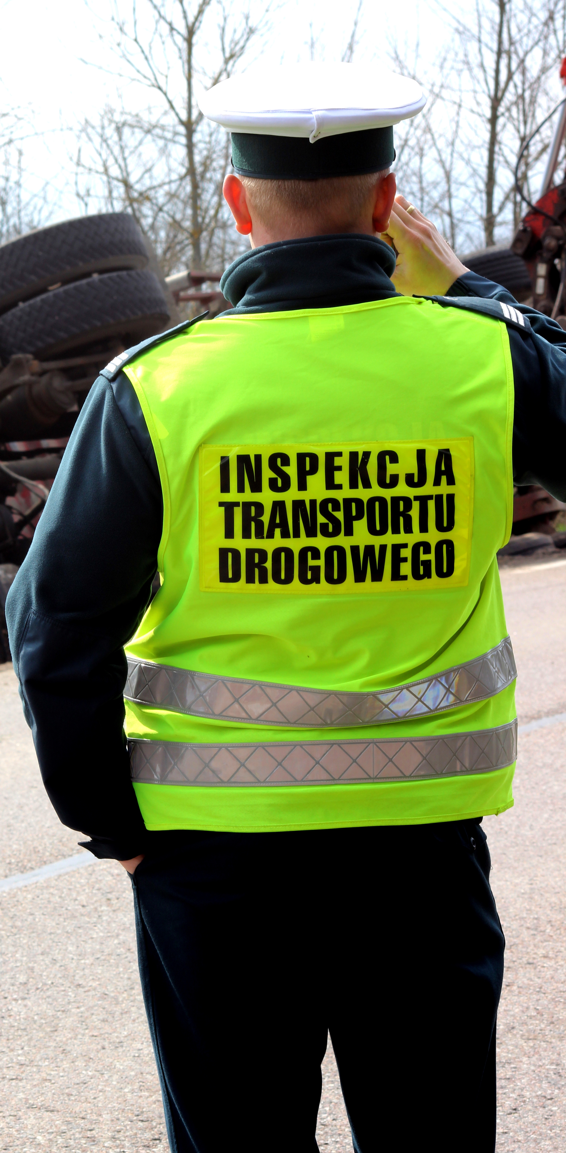
Enforcement Directive
EC proposal
Scope extended to cover working time
Forced cooperation between MS (25 day deadline)
IRU view
Keep current rules, no roadside checks
Enforcement through digitalisatiion (eCMR)
Supports closer MS cooperation

Slide 16
Road user charging
EC proposal
Increased fiscal burden, no earmarking
IRU view
Revenue neutrality, earmarking and a level-playing field between modes
Alternatives
No double payments – adapt fuel taxation
Bus and coach in scope
Revenue should be earmarked to road transport projects
Infrastructure charging based on CO₂ (first EURO norms)
Congestion charging applied to all vehicles
Vignettes to be phased out
Fair treatment of the bus and coach sector vs private cars
Congestion is not an external cost

Slide 17
CO₂ monitoring, reporting & standards
IRU view
Standards need to be realistic and reflect technical complexity of HGVs
CO₂ measurement based on weight or passenger numbers per km to allow better comparisons
Holistic approach on CO₂ reduction (including vehicle operations)
Source: EU reference scenario

Slide 18
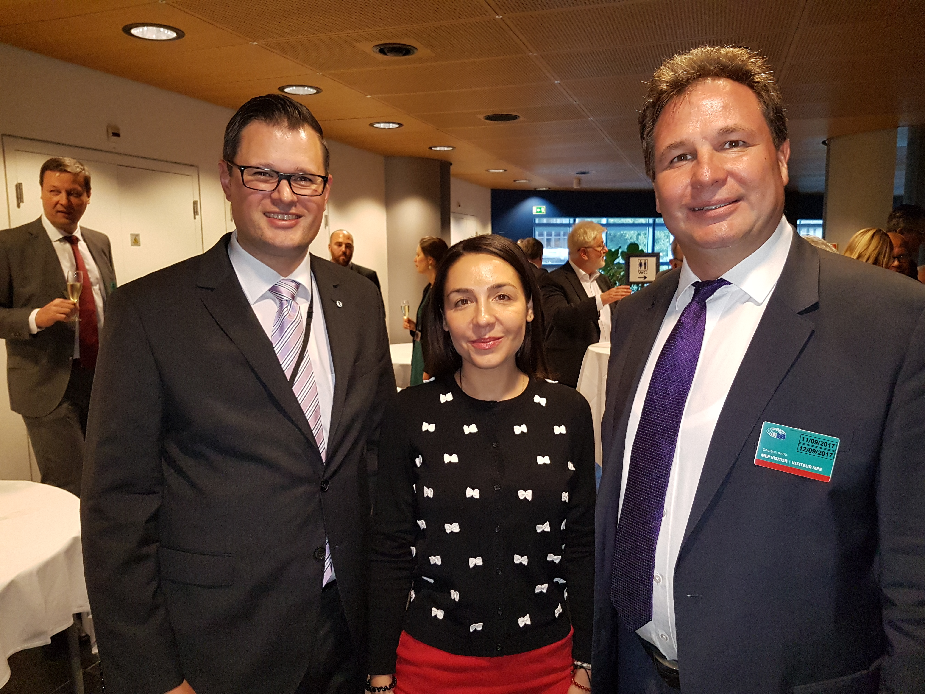
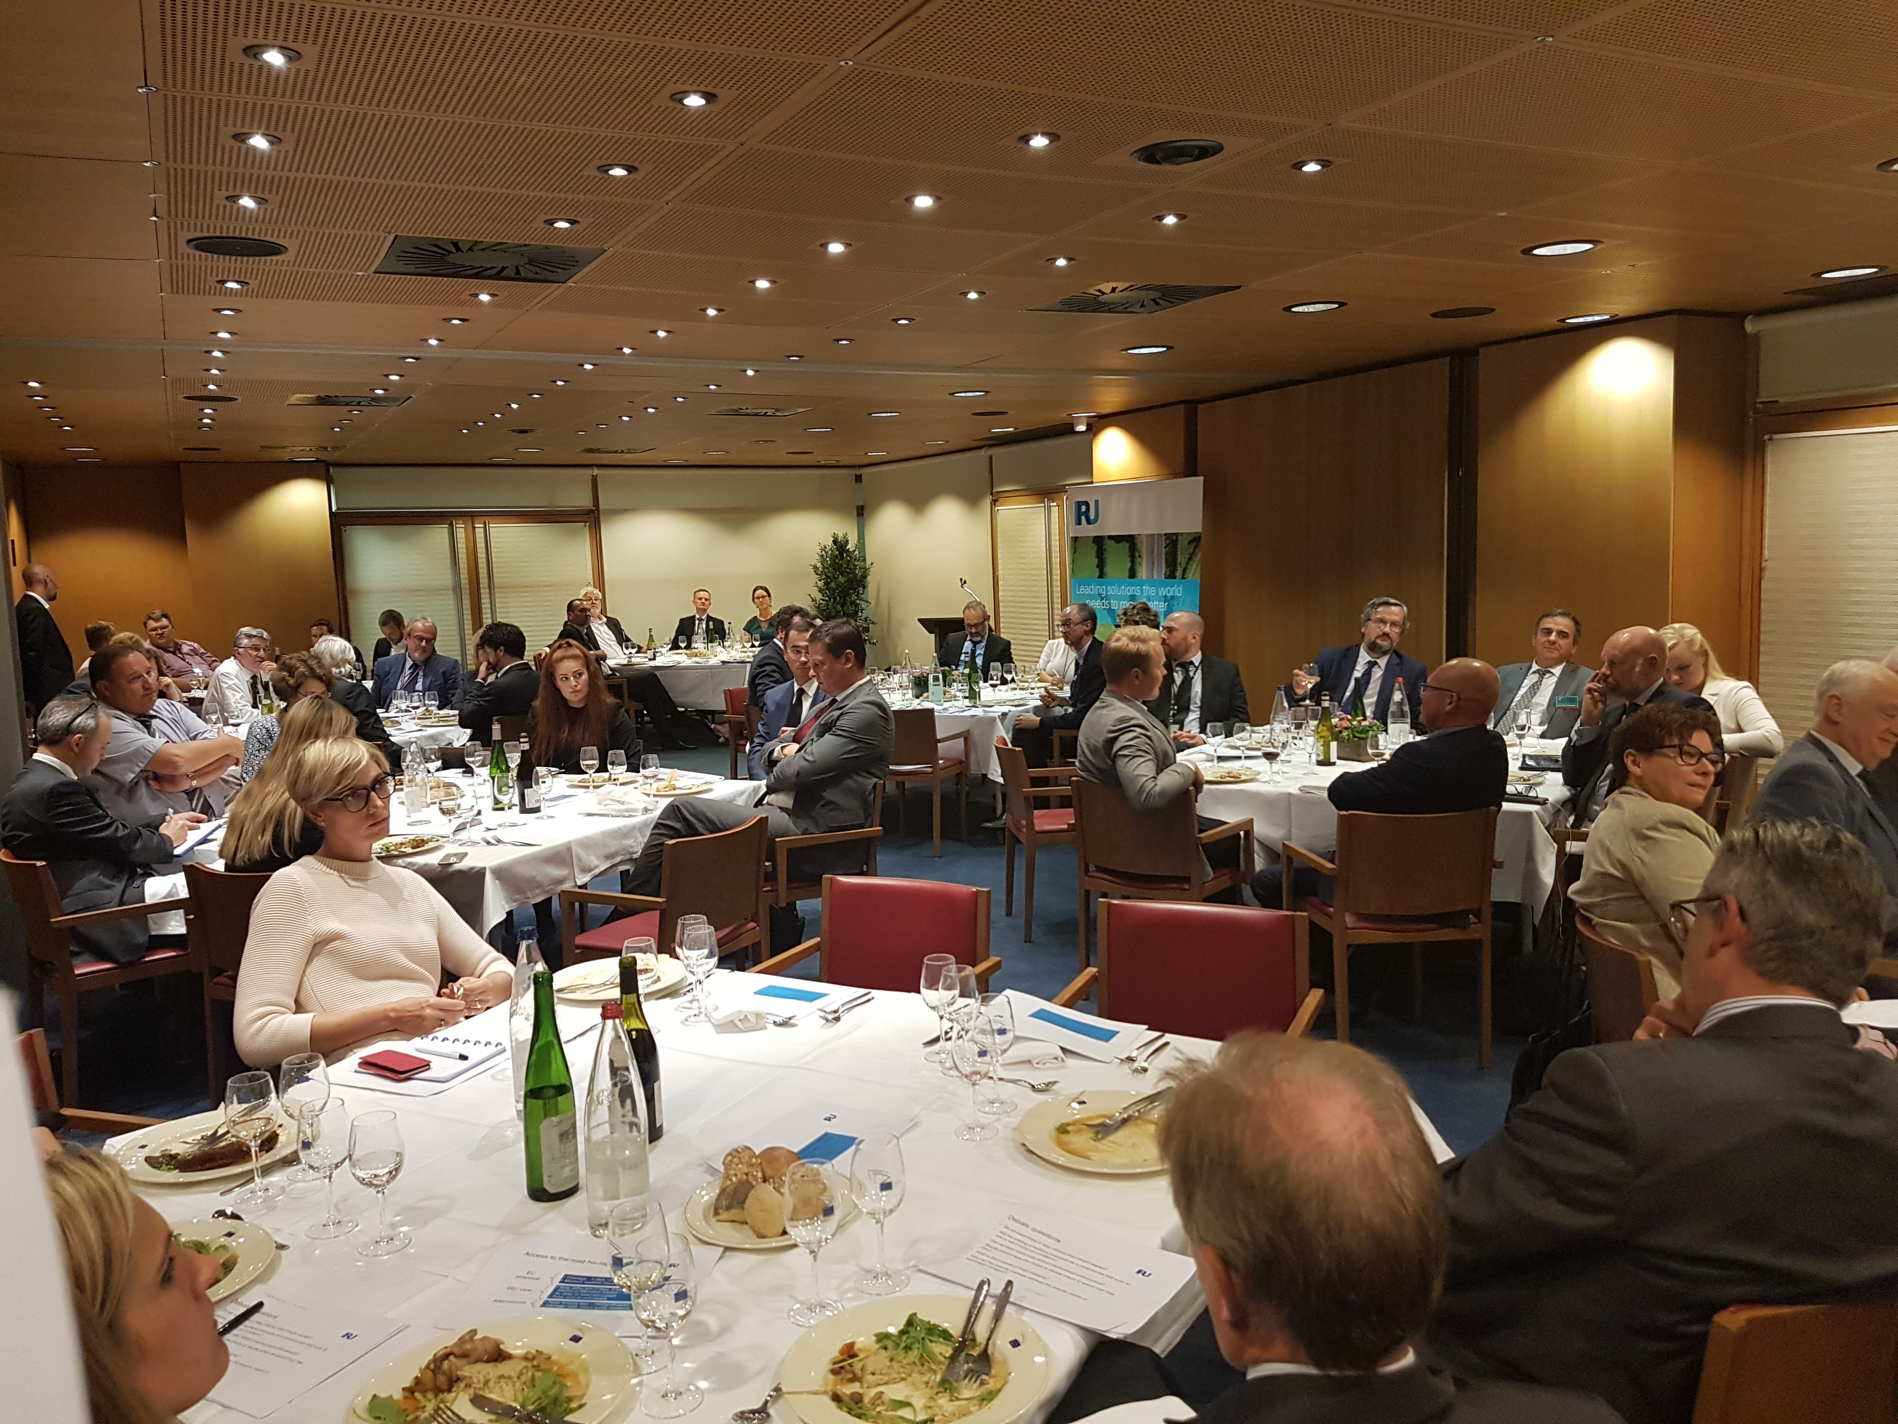
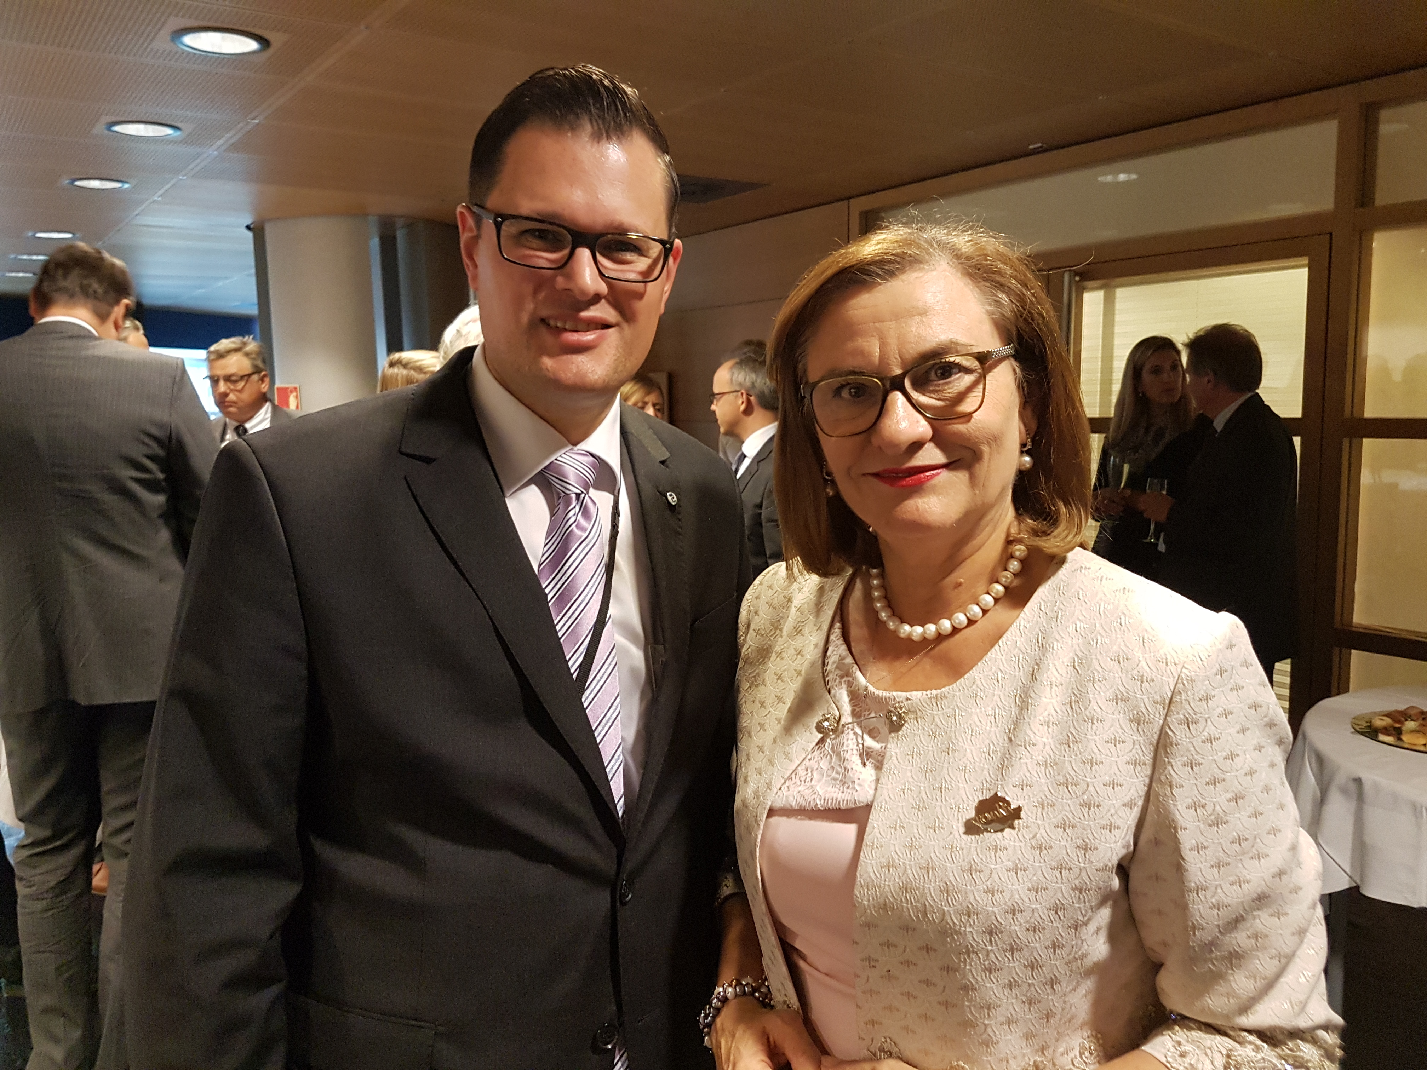
Dinner debate Strasbourg (12. Sept)

Slide 19
Open questions
Will the posting of workers proposals be a compromise that suits no one or will it solve our problems?
Do we want more or less internal market - liberalisation vs protectionism?
Can we have more rules without harmonised enforcement?
Should drivers have the choice to decide where to spend their free time?

Slide 20
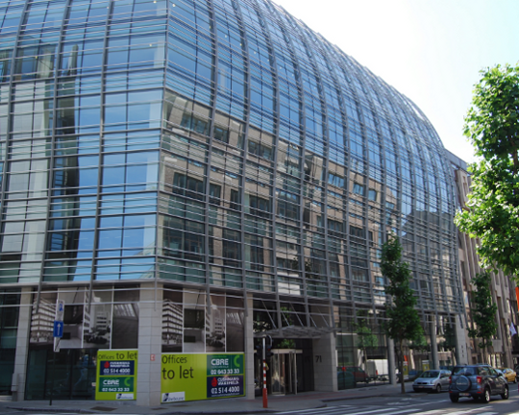
Helping the world get where it needs to be
Our new office address:
Avenue de Cortenbergh 71
1000 Brussels
Belgium

