Slide 1

REGULATIONS AND EUROPEAN BEST PRACTICES IN THE ROAD TRANSPORT SECTOR
UNTRR INTERNATIONAL SEMINAR
Novotel Hotel, Bucharest, Romania
5 December, 2011
Damian Viccars
Head of Social Affairs
and EU Road Safety.

Slide 2
OVERVIEW
A Brief Background to the IRU
The White Paper on EU Transport Policy
Taking Legislation from Paper to Practice: Examples from the EU Aqcuis
  Review of the Digital Tachograph Regulation
  Enforcing EU Driving and Rest Time Rules
  The EU Driver Training Directive
Conclusions
(c) International Road Transport Union (IRU) 2011
Notes:
SO IN THIS PRESENTATION I WOULD FIRST LIKE TO PROVIDE A BRIEF BACKGROUND TO THE IRU, WHO WE ARE AND WHAT WE WANT FOR ROAD TRANSPORT.
SECOND, I WOULD LIKE TO TAKE A LOOK AT THE FUTURE OF TRANSPORT IN EUROPE OR AT LEAST THE WAY THE EUROPEAN COMMISSION SEES IT AS PRESENTED IN THE EU TRANSPORT WHITE PAPER , PUBLISHED EARLIER THIS YEAR.
THIRDLY, THEN WE SHOULD COME BACK TO SOME PRESENT ISSUES ON THE EU’s TABLE U TODAY,
FOR EXAMPLE THE ONGOING REVIEW OF THE EU TACHOGRAPH REGULATION.
AND THEN JUST TWO FURTHER EXAMPLES SHOWING THE CHALLENGES EMERGING FROM THE APPLICATION OF THE CURRENT EU ROAD TRANSPORT ACQUIS, NAMELY THE ENFORCEMENT OF EU DRIVING AND REST TIME RULES AND THE IMPLEMENTATIUON OF THE DRIVER TRAINING DIRECTIVE.
WHAT THESE LAST TWO ISSUES CLEARLY SHOW IS THAT SIMPLY PUBLISHING LEGISLATION IN THE EU’S OFFICIAL JOURNAL OR EVEN A NATIONAL REGISTER DOES NOT MAKE THOSE RULES WORK IN PRACTICE.
INSTEAD AN EFFECTIVE IMPLEMENTATION OF THESE RULES REQUIRES ABOVE ALL COOPERATION BETWEEN ALL THOSE WHO NEED TO IMPLEMENT, ENFORCE AND FOLLOW THEM. THAT IS AUTHORITIES, CONTROL ORGANISATIONS, COMPANIES AND DRIVERS. AND THIS COOPERATION TO FIND BEST PRACTICES MUST OCCUR NOT ONLY AT NATIONAL LEVEL BUT ABOVE ALL AT EU LEVEL TO ENSURE THAT THE EU REGULATORY FRAMEWORK ACHIEVES ITS GOALS IN A UNIFORM WAY ACROSS ALL MEMBER STATES.
FINALLY, WE MAY TRY TO REACH SOME CONCLUSIONS.

Slide 3
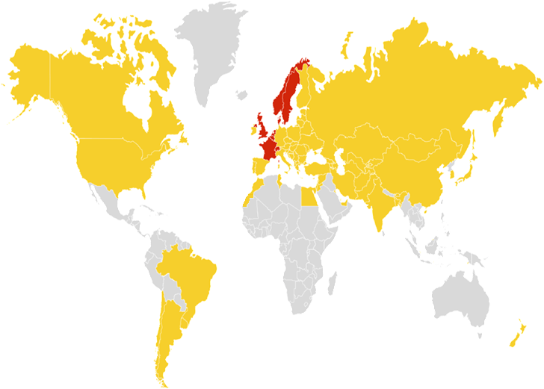








Evolution of IRU Membership
Created
in 1948
National Associations from 8 founding countries
2011
180 Members
74 Countries
Belgium
Denmark
France
Netherlands
Norway
Sweden
UK
Switzerland
Notes:
SO TO START WITH, PLEASE ALLOW ME TO GIVE A BRIEF INTRODUCTION TO THE IRU.
THE IRU WAS FORMED IN 1948 BY 8 COUNTRIES IN WESTERN EUROPE. THE RATIONALE WAS SIMPLE. REMOVING INTERNATIONAL BARRIERS AND FACILITATING INTERNATIONAL ROAD TRANSPORT WAS ESSENTIAL FOR THE RECONSTRUCTION OF EUROPE AFTER THE SECOND WORLD WAR.
SIXTY YEARS LATER THE IRU HAS BECOME A GLOBAL ORGANISATION WITH 180 MEMBERS IN 74 COUNTRIES, ACROSS FIVE CONTINENTS.
THROUGH THIS GLOBAL NETWORK OF NATIONAL EMPLOYER ORGANISATIONS – SUCH AS UNTRR - WE REPRESENT THE OPERATORS OF BUSES, COACHES, TAXIS AND TRUCKS, FROM LARGE FLEETS TO OWNER-OPERATORS.
AND WHEREVER DECISIONS ARE TAKEN IN RELATION TO OUR SECTOR THE IRU IS COMMITTED TO DEFEND THE INTERESTS OF OUR MEMBERSHIP AND THE ADVANTAGES THEY BRING TO SOCIETY.
ITS EASY TO FORGET THAT ROAD TRANSPORT IS NOT SIMPLY A PROBLEM BUT INTEGRAL TO THE WAY OUR SOCIETIES FUCNTION. NO OTHER MODE OF TRANPORT IS DEPENDED ON SO MUCH TO KEEP SUPERMARKETS AND HOSPITALS SUPPLIED OR GET PEOPLE TO WORK, TO SCHOOL OR ON HOLIDAY IN AN AFFORDABLE, GREEN AND SAFE WAY. I THINK WE WOULD CERTAINLY MISS THE 4 MILLION JOBS DIRECTLY PROVIDED BY OUR SECTOR, NOT TO MENTION THE EVEN LARGER NUMBER OF INDIRECTLY EMPLOYED AS A RESULT OF US, IN MANUFACTURING, LOGISTICS AND DARE I SAY IT .. EVEN IN ENFORCEMENT.

Slide 4

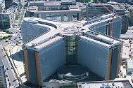
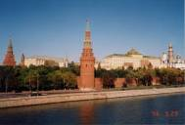
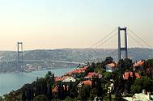
Evolution of IRU Structure
1948
IRU founded in Geneva
1973
IRU Permanent Delegation to the
EU established in Brussels
1998
IRU Permanent Delegation to the
CIS established in Moscow
2005
IRU Permanent Delegation to the
Middle East established in Istanbul
Notes:
SO WITH THESE TASKS, IN MIND OVER THE YEARS THE IRU SECRETARIAT HAS CHANGED TO REFLECT THE GEOGRAPHICAL SPREAD OF ITS MEMBERS AND INTERNATIONAL DEVELOPMENTS.
THE IRU’S HEAD OFFICE IS ESTABLISHED IN GENEVA WHERE WE MAINTAINS LINKS WITH MANY UN BODIES BASED THERE, INCLUDING THE UNECE, THE WORLD TRADE ORGANISATION, THE WORLD HEALTH ORGANISATION AND THE ILO. THE IRU IS ALSO RESPONSIBLE - UNDER UN MANADATE - FOR ENSURING THE PROPER FUNCTIONING OF THE TIR CUSTOMS TRANSIT SYSTEM.
HOWEVER, IN THE 1970’S AS THE EUROPEAN UNION EMERGED AS A SIGNIFICANT PLAYER IN TRANSPORT POLICY, OUR DELEGATION TO THE EU WAS ESTABLISHED IN BRUSSELS. OUR ROLE THERE IS TO INFLUENCE EU LEGISLATION WHICH NOW ACCOUNTS FOR THE OVERWHELMING MAJORITY OF TRANSPORT LAW IN ITS MEMBER STATES.
TWO DECADES LATER WITH THE BREAK UP OF THE USSR, THE IRU SET UP A DELEGATION TO THE COMMONWEALTH OF INDEPENDENT STATES. BASED IN MOSCOW, THE DELEGATION’S OBJECTIVES ARE TO HELP INTEGRATE THE REGION WITH EU TRANSPORT SYSTEMS AND TO ENCOURAGE THE HARMONISATION OF TRANSPORT LEGISLATION. THE ATER AGREEMENT IS AN OBVIOUS EXAMPLE THAT MOST OF YOU WILL BE KNOW WELL.
AND FINALLY MOST RECENTLY, IN 2005 THE IRU OPENED AN ISTANBUL OFFICE TO TAKE ACCOUNT OF THE GROWING TRADE AND TRANSPORT POTENTIAL OF THE MIDDLE EAST AND ITS NEIGHBORING REGIONS.

Slide 5
IRU Priorities
Facilitation
  Road transport Trade, Tourism, Wealth Generation
  Road transport Facilitating movement of goods and people across borders
Sustainable Development
  Innovation, Incentives, Infrastructure
  Standards, Safety, Environment, Skilled and Sustainable Workforce,
Notes:
SO THAT’S THE IRU, ITS STRUCTURE AND WHO WE REPRESENT. BUT WHAT DO WE WANT FOR ROAD TRANSPORT?
THE IRU’S STATUTORY COMMITMENTS TO FACILITATION AND SUSTAINABLE DEVELOPMENT ARE CLEAR. FACILITATION MEANS SUPPORTING ALL MEASURES THAT HELP TO MAKE THE TRANSPORT OF PEOPLE AND GOODS ACROSS BORDERS BY ROAD MORE EFFICIENT.
SECOND, OUR COMMITTMENT TO SUSTAINABLE DEVELOPMENT MEANS WORKING TO ESTABLISH THE HIGHEST PROFESSIONAL STANDARDS IN ROAD TRASNPORT. IMPROVING THE SECTOR’S SAFETY AND ENVIRONMENTAL RECORD AND - VERY IMPORTANTLY - TRYING TO IMPROVE THE STABILITY AND WORKING CONDITIONS OF OUR LABOUR FORCE.

Slide 6
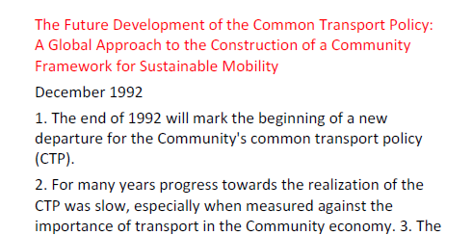
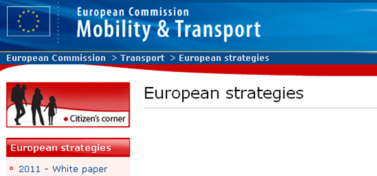
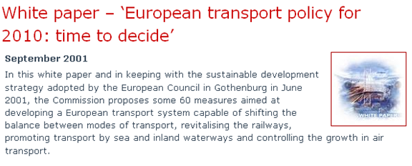
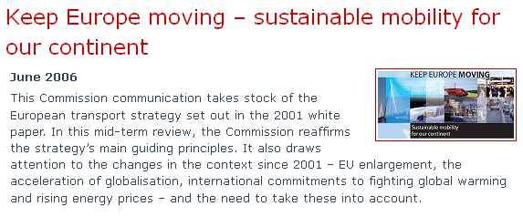
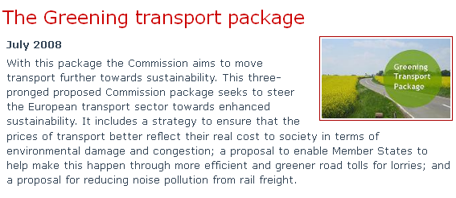
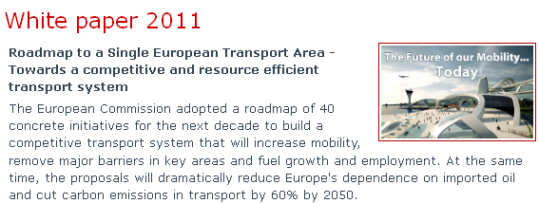


The EC Transport White Paper 2001-2011…
1992: EC launches opening of the transport market.
2001: EC wants forced modal shift.
2006: EC agrees: forced modal shift does not work!
2011:
EC returns
to forced
modal
shift!
Notes:
FIRST WHAT ARE TRANSPORT WHITE PAPERS?
THE 2011 PAPER IS ONLY THE LAST IN A SERIES OF EU GRAND PLANS FOR DETERMINING THE FUTURE OF TRANSPORT IN EUROPE
EACH HAS BEEN CHARACTERISED BY A PARTICULAR PHILOSOPHY AND DIRECTION OFTEN WITH ROAD TRANSPORT FEATURING AS THE CENRAL FOCUS.

Slide 7
The EU Transport White Paper 2011
Challenges to overcome:
  Congestion, Reduction of GHG Emissions, Dwindling Energy Supplies, Reduce road fatalities, Infrastructure for an enlarged EU, Global Economic Competition.
A vision for the transport system of 2050 :
  Transport to use less energy and use cleaner energy, exploiting a multimodal and ‘intelligent network’.
  Creating a competitive and resource efficient transport system.

Slide 8



IRU views on the White Paper…
Completion of internal market
Improvement of competitive position
Resource efficient transport system
C0₂ emissions
Forced modal shift disguised under co-modality
How to achieve the targets?
Which alternative fuels?
Who to finance ?
Notes:
FIRST ON THE POSITIVE SIDE: THE EC’S COMMITMENT TO THE COMPLETION OF THE INTERNAL MARKET IS MOST WELCOME.
WE CAN ONLY SUPPORT THE EU’S ANNOUNCED GOAL OF A SINGLE EUROPEAN TRANSPORT AREA IN WHICH ALL RESIDUAL BARRIERS BETWEEN TRANSPORT MODES AND BORDERS ARE REMOVED.
THE SAME CAN BE SAID FOR THE GOAL OF IMPORVING THE EU’S COMPETITIVE POSITION VIS A VIS ITS NEIGHBOURS
AND RESOURCE EFFICIENCY IS ALSO A PLUS. IF WE CAN ACHIEVE INCREASED FUEL EFFICIENCY THIS WILL MAKE A DIFFERENCE TO THE BOTTOM LINE OF TRANSPORT COMPANIES. WHO WOULD NOT WANT TO BE MORE FUEL EFFICIENT AND MORE ECONOMICAL AS A RESULT
AND ON CO2 LET’S FACE IT. WE OURSELVES AS THE IRU HAVE PLEDGED TO REDUCE OUR CO2 EMISSIONS BY 30% BY 2030.
HOWEVER, WE DO HAVE PROBLEMS WITH MUCH OF THE STRATEGY THAT THE EC PRESENTS TO ACHIEVE THIS GOAL.
OUR BIGGEST CONCERN IS THAT FORCED MODAL SHIFT FROM IS THE DISGUISED – AND NOT ALWAYS SO WELL DISGUISED - OBJECTIVE OF THE WHITE PAPER.

Slide 9

What do we REALLY need?
Efficient, sustainable transport system including road freight with non-discriminatory pricing.
Greening of all transport modes at-source.
Possibilities to innovate (weights and dimensions)
New vehicle technologies and economically viable alternative fuels.
Good and safe infrastructure
Practical support for SMART MOVE’s aim to double the use of bus and coach transport.

Slide 10


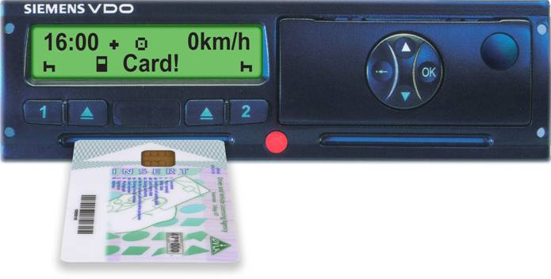
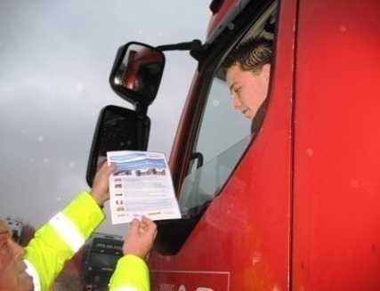

The EU Social Rules Framework
Driving and Rest Time Rules – in force from 11 April 2007
    Establishes basic rules for driving and rest time
Digital Tachograph – compulsory from 11 May 2006
    In all new vehicles for recording driving rest times rules
Social Rules Enforcement – in force from 1 May 2006
    Minimum new controls on driving and rest times
Working Time Directive – from 23 March 2005
    Sets limits for maximum total working time
Driver Training Directive – from 10 September 2008/9
    Introduces compulsory CPC qualification and periodic training

Slide 11

Amending the Tachograph Regulation
Security is at the heart of the EC review. Tachograph fraud will undermine:
  regulatory compliance & respect for key areas of the EU road transport social rules framework,
  the businesses of lawful operators & image of the sector
  road safety, working conditions and fair competition
No excuses, but many causes of fraud
  Fierce competition,
  Rising operating costs especially fuel,
  Fall out of economic crisis,
  Excessively rigid rules or heavy handed enforcement

Slide 12
Review of the Tachograph Regulation
IRU Supports:
  Proportionate steps to reinforce the technical security of the device, building on existing measures
  More secure encryption codes, in line with real threats but supported by an efficient migration strategy.
  Mobile signals to improve targeted enforcement but with safeguards and proven technology
IRU Opposes:
  Compulsory GNSS: will encourage an expensive tachograph technology arms race without delivering any security guarantees.

Slide 13
Review of the Tachograph Regulation
The tachograph must retain its policing function but must also become an aid for drivers & firms
  Better and safer placement of the device within the vehicle,
  Better integration of ITS technologies via a standardised interface,
  Reduced administrative burdens and simplified tasks for drivers, for example by eliminating attestation forms,
  Common EU standards for training enforcers,
  Optional merging of driver licences and driver cards
13
Notes:
13

Slide 14


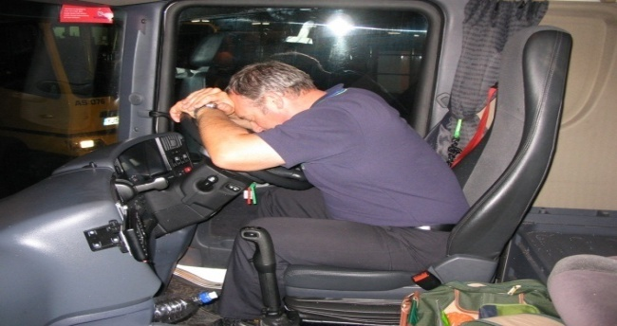
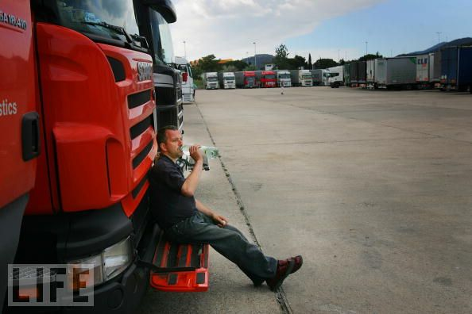


  Driving and Rest Time Rules Regulation 561/2006/EC
  Sets maximum driving hours and minimum rest for drivers of vehicles over 3.5
  Vital to improve road safety and working conditions
  Vital for fair competition between drivers of different EU countries.
  Less flexibility for drivers and companies to accommodate their own needs and work life balance
  Lack of suitable rest facilities

Slide 15
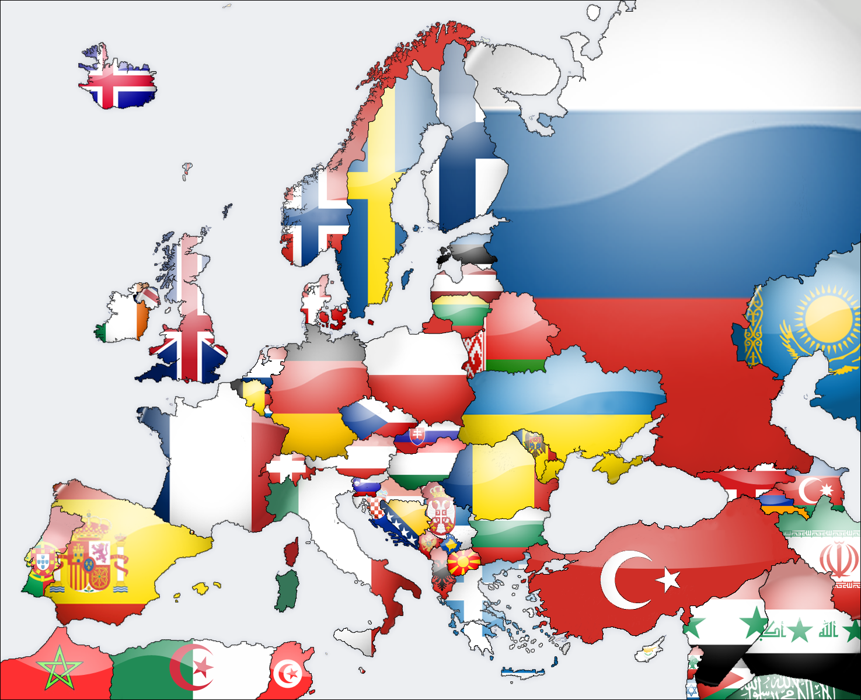
The EU Enforcement Problem
A COMMON REGULATORY FRAMEWORK
BUT A FRAGMENTED ENFORCEMENT SPACE.

Slide 16
Problems with Driving and Rest Time Rules Enforcement
  Too many national & regional interpretations & enforcement practices.
  Non-recognition of national tolerances or exemptions.
  Variable quality of enforcement.
  Arbitrary / unfair enforcement and sanctioning policies.

Slide 17
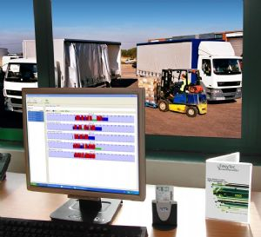

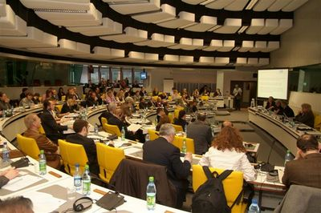
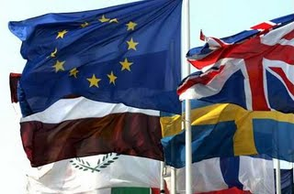
Enforcing EU Social Rules
EU Enforcement Directive 2006/22/EC
  Minimum requirements for enforcing driving and rest time rules
  Committee and co-operation between Member States
    Promote a common approach to rule interpretations, enforcement and categorization of infringements,
    Produce official statistical reports on enforcement and compliance.
    The IRU is an active observer to this Committee

Slide 18
EU Enforcement Committee:
Guidance, Decisions, Recommendations
  GUIDANCE NOTE 1 Exceptional deviation to find a suitable stopping place
  GUIDANCE NOTE Recording driver's travelling time
  GUIDANCE NOTE 3 Interrupting driver's break or rest
  GUIDANCE NOTE 4 Driving time recorded in frequent stop operations
  GUIDANCE NOTE 5 Attestation of activities
  GUIDANCE NOTE 6 Recording of time spent on ferry or train
  COMMISSION DECISION: Calculating daily driving time after insufficient rest
  EU Driver Attestation document and modification
  Categorisation of infringements table
  Common EU guidelines for national risk rating systems
  Inspection of tachographs and workshop security

Slide 19
TISPOL, ECR, IRU ‘Declaration of Intent’ March 2011
  To build a common EU Enforcement environment, remove unnecessary costs, legal uncertainty and boost compliance.
  Harmonised interpretations and enforcement requirements.
  New control culture using education as well as sanctions.
  ECR Complaints desk & work towards fair, dissuasive, proportionate and better aligned penalties.
  Common standards for training especially through the TRACE project and longer term strategic partnership with EC.
  Intensified cooperation in the field of safe and secure parking especially through the TRANSPark project.

Slide 20
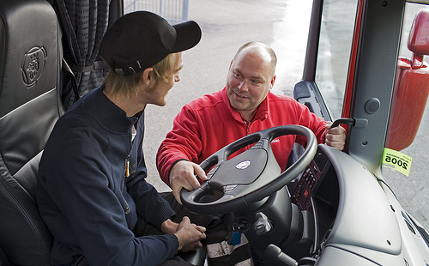
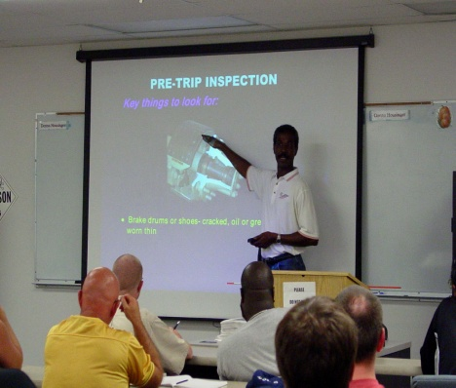

Driver Training Directive
Directive 2003/59/EC’s main goals are:
  Improve road safety
  Ensure that all drivers – both in goods and passenger transport - are sufficiently skilled to fulfil job demands
  Harmonise Community rules to avoid unfair competition
Certificate of Professional Competence (CPC)
  Commercial drivers must obtain (in addition to the required licence) an EU CPC issued by Member states following 240 hours compulsory training plus a test or an examination
  Knowledge and skill requirements are specified
  Training and examination centres must be approved by Governments
  All drivers must undergo 35 hours of periodic training every 5 years to retain the CPC

Slide 21

Transposition
Article 3: Qualification and Training
Source: EC DG Transport

Slide 22
Initial qualification process
Option 1: course attendance and test
Option 2: test only
Both systems

Slide 23
Initial Qualification
Article 5: Age limits
Source: EC DG Transport

Slide 24
Periodic Training
& Transition Periods
Article 8: Certifying Periodic Training
Vehicle: C1, C1+E and C, C+E
“Until 2016 the date
of issuance of the driving
licence will be taken
into account for
checking the
acquired rights of the
concerned drivers”
Unknown
IT
EL
Source: EC DG Transport

Slide 25
Community Code
Article 10: Community Code
Source: EC DG Transport

Slide 26
EU Driver Training Directive
Further variations in:
  Content and quality of training.
  Costs and financing of training.
  Training and approval of instructors and training centres.
  Recognition of foreign training.
Concerns about:
  Scheduling of periodic training
  Correct enforcement of the Directive abroad
  National training capacity
Key Challenge: How to ensure diversity without undermining the objectives of the legislation.
Variation
Variations in

Slide 27


EU Driver Training Directive
Key Challenge: While respecting the need for national diversity, how to ensure the objectives of the legislation are not undermined.
European Best Practices are essential.
IRU and IRU Academy active on this!
  STARTS project:
  http://starts.iru.org/en_home
DRIVEN project:

Slide 28
Conclusions
Brussels is and will continue to be a major source of transport legislation that affects you and your businesses.
The IRU is your voice to ensure your interests are protected as much as possible in the legislative process.
We are also working to ensure that legislation is applied properly and improved once in place.
Cooperation amongst all stakeholders is key at national and international level.

Slide 29

www.iru.org

